Slide 1

ASSESSMENT 1 Submitted by: Shivam Submitted tO: Mr. Anupam

Slide 2
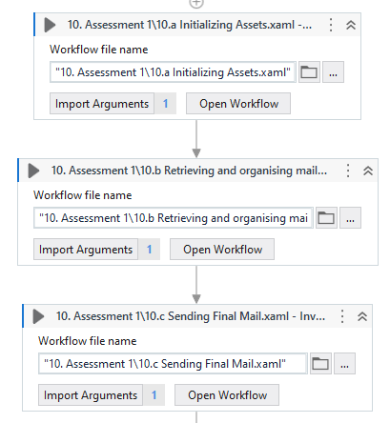
MAIN SEQUENCE

Slide 3
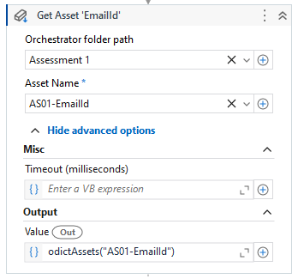
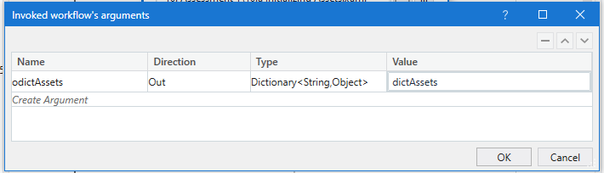
10.a Assets Initialization

Slide 4
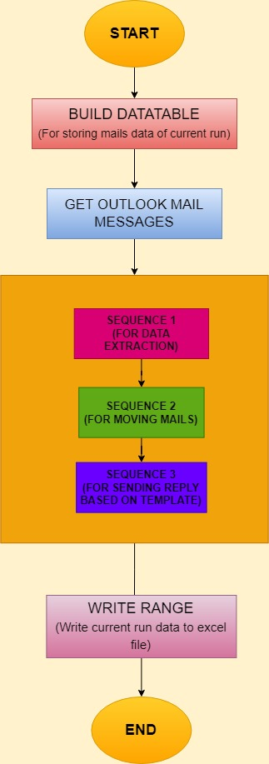
10.b

Slide 5
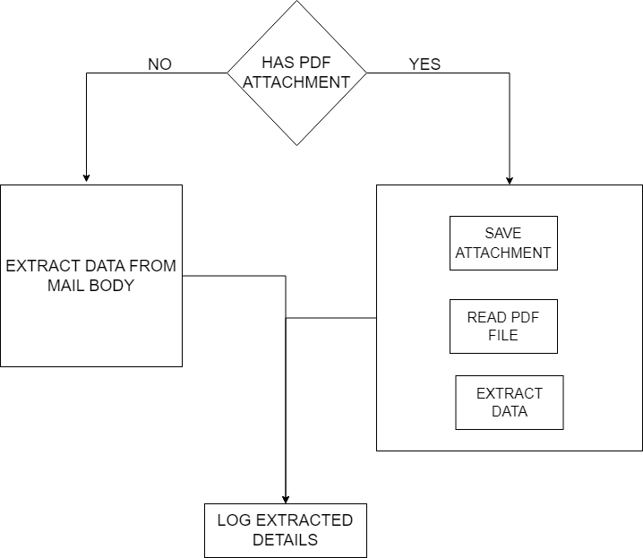
SEQUENCE 1

Slide 6
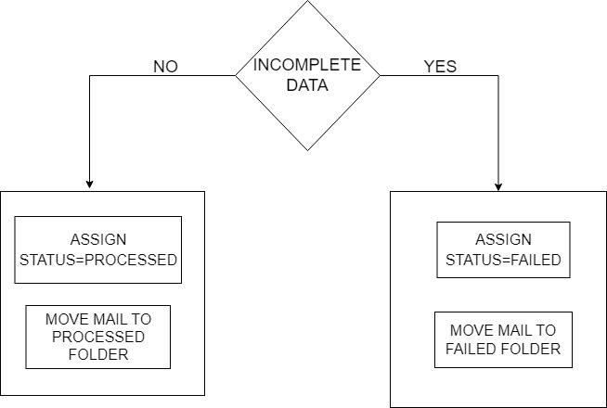
SEQUENCE 2

Slide 7
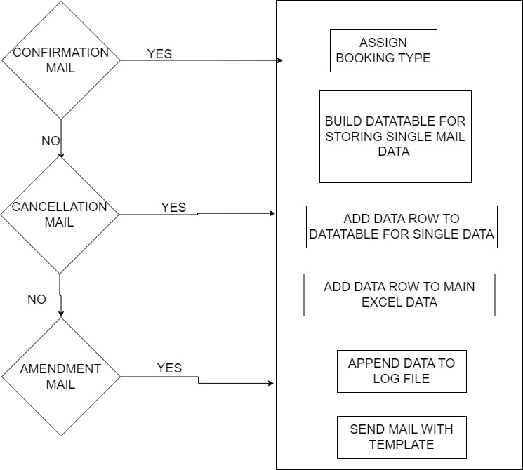
SEQUENCE 3

Slide 8
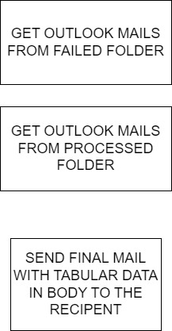
10.C Sending Final Mail

Slide 9
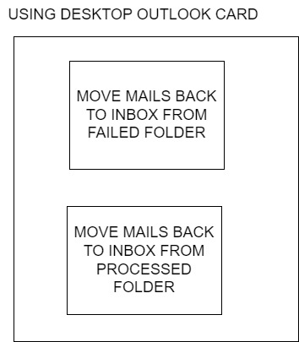
10.d System Initialization For Next Run

